Slide 1


1/26
Ran Regev
C++ Developer since 1999, Work for Beyeonics, ISO member, WG21, SG21 participant, Israeli NB

Slide 2


Introduction to C++26, Contracts MVP
2/26
In this talk:
Contracts Target: Find Bugs
Syntax
Contracts are everywhere
Contracts Facility: To Code
Narrow and Wide Contracts
Contract violation results in Undefined Behavior
Contract Violation Handler
Contracts Facility: UB → Well Defined
Controlling Contracts: enforce, observe, ignore
Contracts Checks: No Transformation
Contracts Checks: Side Effects
Virtual Functions
Constant Evaluation
Throwing Contract Violation Handler

Slide 3

Introduction to C++26, Contracts MVP
3/26
Not In this talk:
The History of Contracts
Standardization Process
Future, Non-MVP features
Design Decisions
Corner Cases
Mechanics Details
Gotbolt Online Examples
Static Analyzers
The Lakos Rule
--std=c++23 –O2 –fcontracts – fcontracts-nonattr x86-64 gcc (contracts natural syntax)

Slide 4

Contracts Target: Find Bugs (at runtime)
4/26
Bugs are Solved by Humans
Errors are Handled by code
Bugs are not Errors
Contracts exposes bugs at runtime
Me against SG21:
When Contracts are violated when enforced:
The program must stop.
(This is the idea; the details are quite different)

Slide 5

Syntax (In a Nutshell)
5/26
Declaration
double foo(int x)
pre(x > 0)
post(ret: ret < x);
Definition
double foo(int x)
{
/* code */
contract_assert(x > j);
/* code */
}

Slide 6

Contracts are everywhere
6/26
Contracts are everywhere
Program
Object
Input parameters
Output parameters
Local
Many times contracts are given as Plain Language Comments
Not all Contracts may be expressed in code

Slide 7

Contracts are everywhere (Compile time)
7/26
Return type and parameters types
double add(double x, double y);
Throwing
void swap(A&, A&) noexcept;

Slide 8

Contracts are everywhere (Runtime)
8/26
// x > 0 && return value > 0
double my_math::sqrt(double x)
// at this point p is not null for sure
*p += 4;
// s.length() == ret.length() - 1
string append(const string& s, char c);

Slide 9

Contracts Facility: To Code
9/26
The Contracts feature turns plain language contracts into explicit code
contract_assert(g_initialized);
reference front()
pre(not empty());
double sqrt(double x)
pre(x > 0)
post(r: r > 0);
int& i = (contract_assert(p!=nullptr), *p);

Slide 10

Contracts Facility: To Code, not always possible
10/26
Not all requirements can be expressed as contracts:
Compare comp is used throughout for algorithms assuming an ordering relation
Setting explicit contracts does not guarantee correctness:
bool hold_my_shares()
post(profit==true);

Slide 11
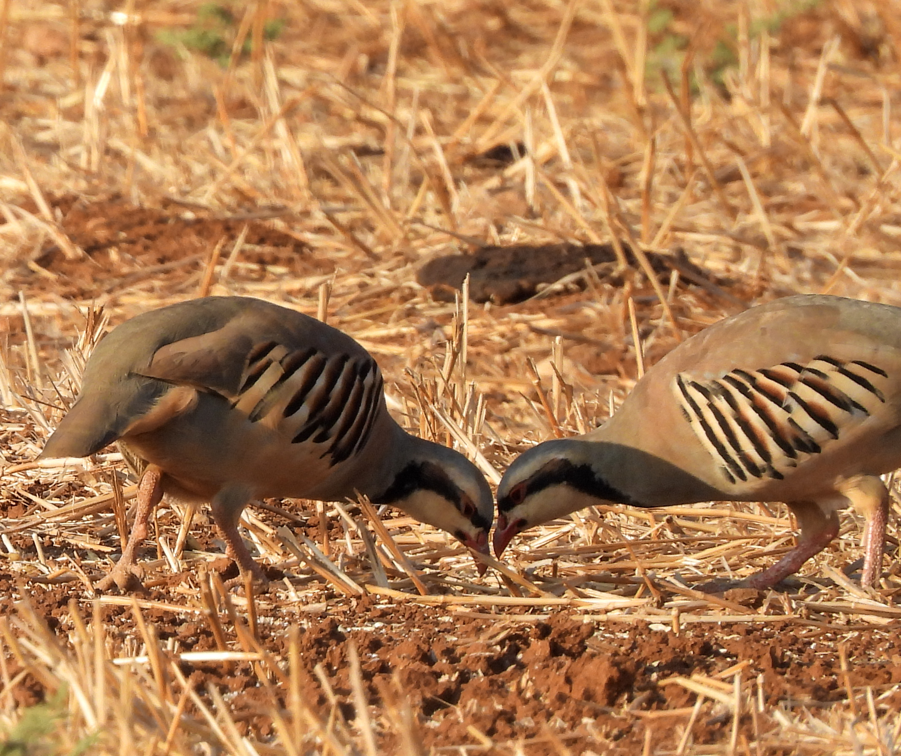
Narrow and Wide Contracts
11/26
A function that accepts any input has a wide contract
A function that is limited in its acceptable inputs has a narrow contract
Narrow contracts limits the possible values of a type
Throwing exceptions, returning errors – are part of the contract
Fundamental Understanding:
Values or States that are out of contract are bugs – not something to handle

Slide 12

Narrow and Wide Contracts
12/26
std::vector
reference operator[](size_type pos)
// narrow: pos < size()
reference at(size_type pos)
// wide (throws if out of bound)
reference front()
// narrow: not empty()
vector(vector&&)
// wide

Slide 13


Contract violation results in Undefined Behavior
13/26
When we call a function out of contract the result is undefined (UB)
We tend to divide into two undefined behaviors
Library UB
Language UB
Library UB may result in a Language UB
Language UB may result in many ways

Slide 14

Contract violation results in Undefined Behavior
14/26
class QueueReceiverMaster {
public:
// the behavior is undefined if receivers are
// set after the call to Start(), or when are
// set more than once
void SetReceivers(std::list<QueueReceiver> receivers);
public:
void Start();
void Stop();
void Join();
/* … */
};

Slide 15
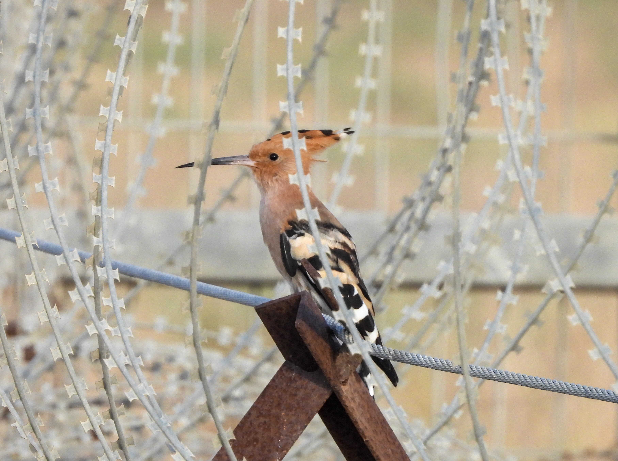
Contract Violation Handler
15/26
The contract violation handler is a built-in but replaceable function that is called upon a contract violation
The input for the function is a struct with all the required information to log the violation:
void ::handle_contract_violation(
const std::contracts::contract_violation& cv );
Note: log, not handle
Me (and others) against S21 – we must normatively require obfuscation of some of the data that is kept in the binary for the use of the violation handler. Namely, the violating expression’s text and the source location of the violation.

Slide 16

Contracts Facility: UB → Well Defined
16/26
Given the Contract Violation Handler function
We declared out-of-contract behavior. Therefore -
We changed UB to well defined behavior. But -
We did not widen the function’s contract

Slide 17

Controlling Contracts: enforce, observe, ignore
17/26
int sharpness(const image& im)
{
// calculate sharpness
// runs for 2ms
}
void find_edges(image& im)
pre(sharpness(i) > 8000)
{}

Slide 18

Controlling Contracts: enforce, observe, ignore
18/26
How to choose semantics is implementation defined
Implementation may choose to set the semantics at any phase
Compile (via compilation flags for instance)
Link (via linker flags for instance)
Load (via ??)
Run (via environment variables for instance)
It is implementation defined of how to mix modes of :
Libraries with different semantics
Contradictions between semantics in different phases
Implementation that provides only the ignore semantic is still conforming (however would be considered low QoI)

Slide 19

Contracts Checks: No Transformation
19/26
It is crucial that contract checks don’t modify the program behavior
int budget()
post(r: (r -= 1000)); // wrong, ill-formed
<template class T>
struct container {
bool add(T);
bool empty() const;
T& front()
pre( not empty or add(T{}) ); // wrong, ill-formed };

Slide 20

Contracts Checks: Side Effects
20/26
It is impossible to limit all side effects
Sometimes side effects are good
Memory Allocation
Logs
Statistics
Side effects may change the behavior of the program or the entire system
Memory being acquired (even if released)
Logs are getting bigger faster
Functionality that is based on contract statistics happens/does not happen

Slide 21

Constant Evaluation
21/26
Compilation may have the same semantics as execution semantics: ignore, observe, enforce
It is implementation defined which of the semantics to provide
When constantly evaluating a contract:
Ignore – no evaluation at all.
Observe – diagnostics (warning)
Enforce – ill-formed (compilation error)
Contracts are constantly evaluated if and only if the expression they check is constantly evaluated

Slide 22
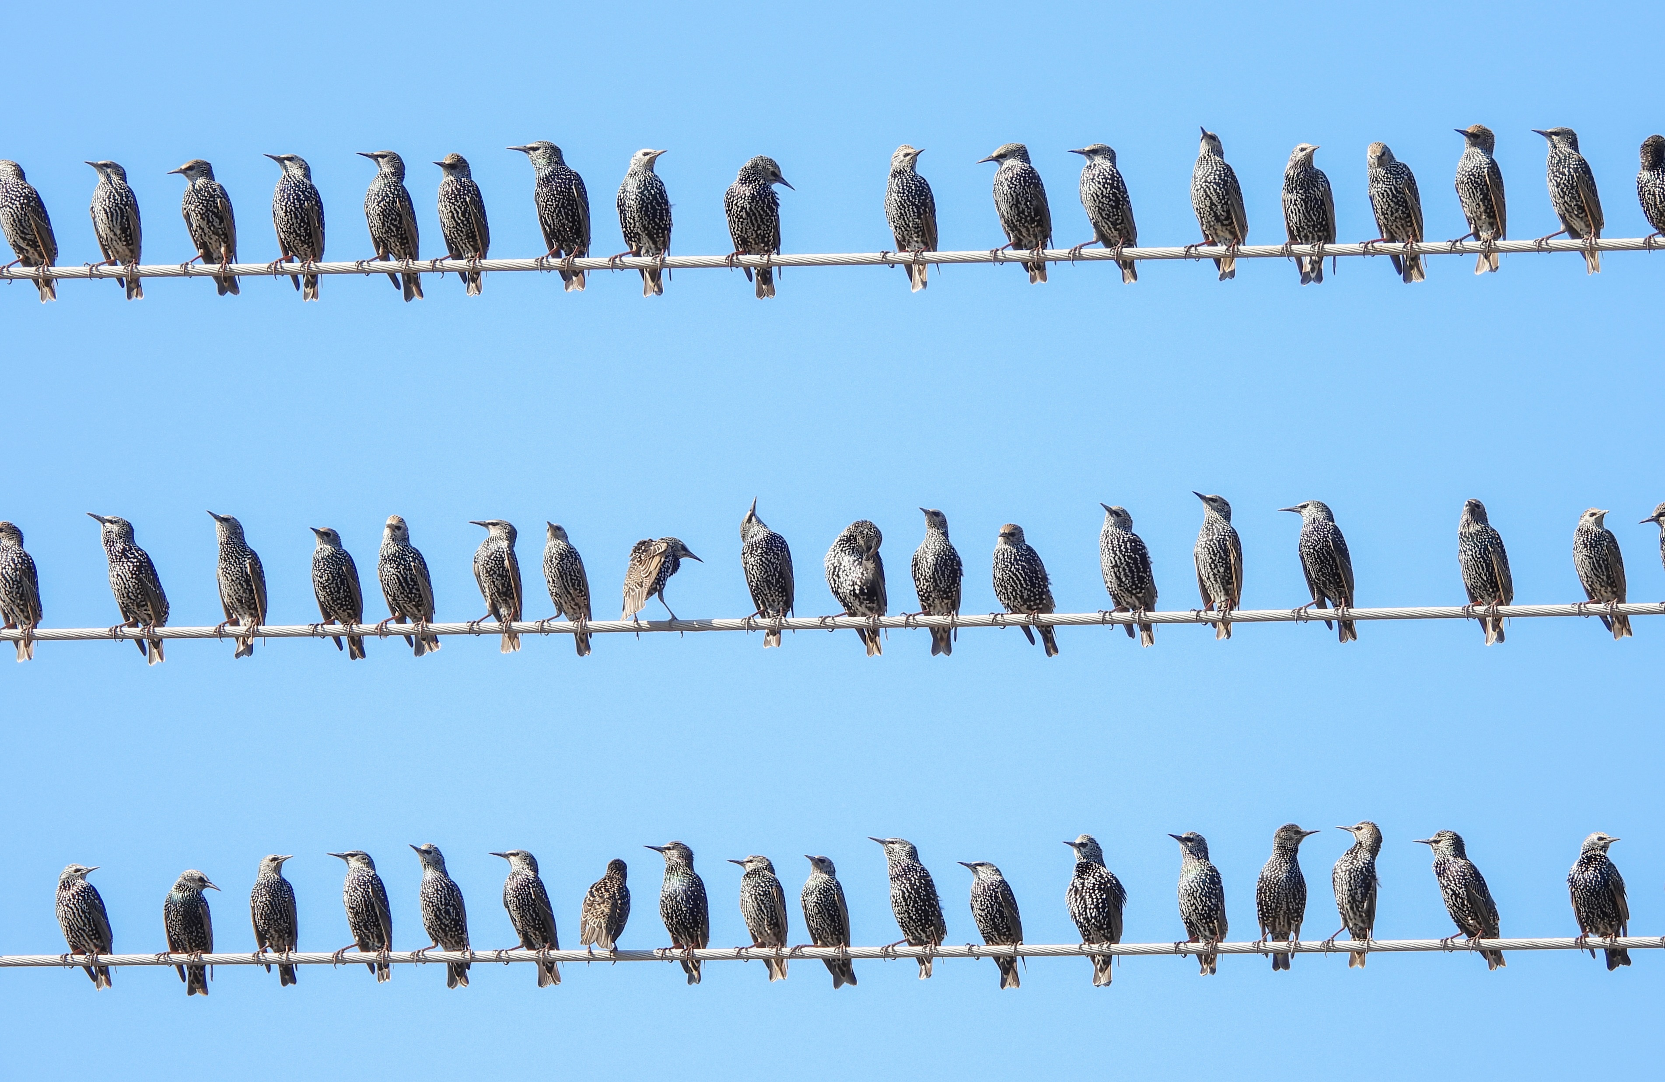
Virtual Functions
22/26
No Consensus in SG21
Probably will end up as ill-formed for all virtual functions for the MVP
Farther, deeper discussion immediately after forwarding contracts design up the process (LEWG, EWG)
View I
struct base {
virtual void foo()
pre(x)
post(y) = 0;
};
void bar(base& b) {
// base::foo()'s contracts
// must hold, no matter what
b.foo();
}

Slide 23
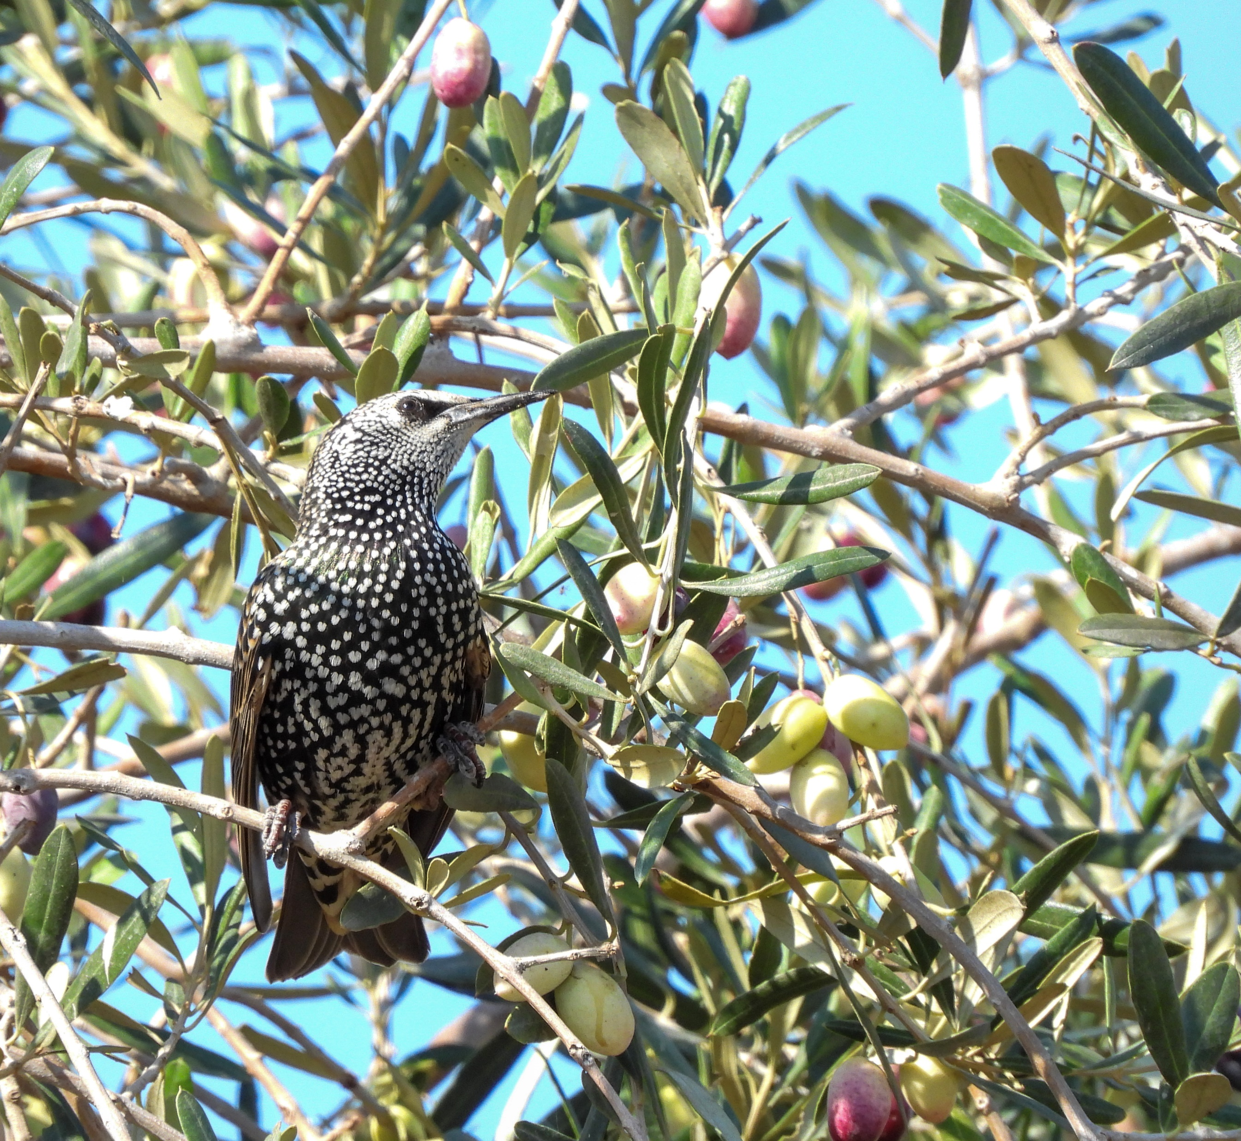
Virtual Functions
23/26
class Car {
public:
virtual void drive(int speed)
pre( speed < 100 );
};
class FastCar : public Car {
public:
void drive(int speed) override
// widen Car’s contracts
pre( speed < 169 );
};
View II

Slide 24

Throwing Contract Violation Handler
24/26
With a throwing contract violation handler, we:
Handle instead of Solve
Widen the function contract
Get a huge confusion about
noexcept(contract_assert(false));
My latest attempt:
Convince SG21 to enable users that want to, to mark handle_contract_violation with noexcept during compilation

Slide 25


Questions
25/26

Slide 26

26/26

